Slide 1


SMART WATER FOUNTAIN
The Smart Water Fountain project aims to improve public water fountains by implementing IoT sensors to track water flow, detect malfunctions in real-time and provide residents with a user-friendly mobile app.

Slide 2

PROJECT DEFINITION
1
Real-time Monitoring
2
Efficient Water Usage
Track water usage and flow
rates in real-time.
Properly maintain water fountain operations to ensure efficient water usage without affecting demand.
3
Malfunction Detection
4
Resident Awareness
Implement sensors that detect and report malfunctions and issues in real-time.
Create a user-friendly mobile app to inform residents about the status and availability of nearby water fountains.

Slide 3
PROJECT OBJECTIVES
1
REAL-TIME WATER FOUNTAIN MONITORING
Sensors track water usage and flow rates in real-time. This helps in understanding the usage patterns and identifying any anomalies.
2
EFFICIENT WATER USAGE
Water fountain operation is optimized to ensure efficient water usage without affecting public demand. Smart algorithms adjust the water flow based on demand and weather conditions.
3
MALFUNCTION DETECTION
Sensors detect and report malfunctions or issues, such as low water pressure or equipment failures in real-time. This enables prompt maintenance and reduces downtime.
4
RESIDENT AWARENESS
Provides residents with easy access to information about the status and availability of nearby water fountains with a user-friendly mobile app. They can find the nearest working fountain and even receive notifications about maintenance or closures.

Slide 4
DESIGN THINKING
Real-time Monitoring
Efficient Water Usage
Malfunction Detection
Flow rate sensors that are compatible with IoT technology will be utilized to track water usage and measure flow rates in real-time.
Optimize the water fountain's operation and monitor water pressure with IoT-compatible pressure sensors to ensure efficient water usage without affecting demand.
Implement IoT sensors for malfunction detection and real-time issue reporting, such as low water pressure or equipment failures
RESIDENT AWARENESS
Create a user-friendly mobile app using cross-platform development frameworks like React Native or Flutter that provides information in real-time about the status and availability of nearby water fountains.

Slide 5
TECHNOLOGY STACK
IOT CONNECTIVITY
BACKEND AND DATA PROCESSING
Python programming language
Database (PostgreSQL or MongoDB)
Data Analytics and Anomaly Detection Algorithms (Pandas, NumPy)
IOT SENSORS
Flow Rate Sensors
Communications Protocols (MQTT)
Pressure Sensors
Water Quality Sensors
Connectivity Options (e.g., Cellular networks, Wi-Fi, or LoRaWAN)
USER INTERFACE
SECURITY AND AUTHENTICATION
SCALABILITY AND CLOUD INFRASTRUCTURE
Mobile App Development (React Native or Flutter)
Cloud Infrastructure Providers (e.g., AWS, Azure)
Data Encryption (HTTPS)
User Authentication Mechanisms (OAuth 2.0, JWT)
Mapping and Geolocation APIs (Google Maps API)
Containerization Technologies (Docker) and Orchestration Tools (Kubernetes)

Slide 6
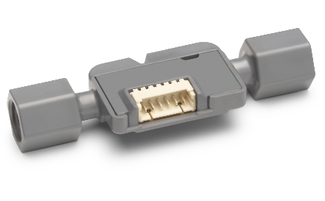
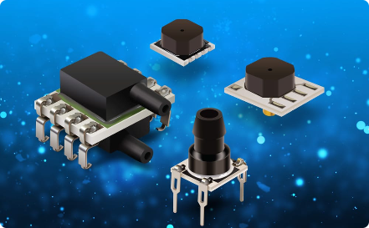
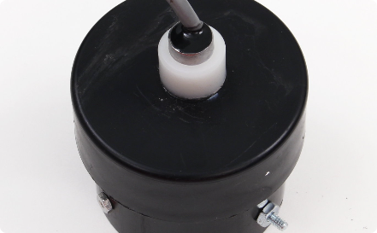
IOT SENSORS
FLOW RATE SENSORS
PRESSURE SENSORS
WATER QUALITY SENSORS
Flow rate sensors are IoT-compatible sensors that detect water flow and contribute to real-time monitoring of the water fountains.
Pressure sensors detect the water pressure within fountains to ensure optimal operation while maintaining efficient water usage.
Iot-enabled water quality sensors assess water safety parameters to maintain consistent water quality.

Slide 7

BACKEND AND DATA PROCESSING
1
PYTHON
2
DATABASE
3
DATA ANALYTICS
Python will be used as the primary programming language for the backend of the water fountain status platform.
A robust database system such as PostgreSQL or MongoDB will store sensor data securely.
Python libraries like Pandas and NumPy will be implemented for data analytics and anomaly detection algorithms to identify malfunctions.

Slide 8
TESTING AND MONITORING
1
AUTOMATED TESTING
2
CONTINUOUS INTEGRATION/CONTINUOUS DEPLOYMENT (CI/CD)
Automated testing frameworks like Selenium and Appium for mobile app testing and unit testing for backend components will be implemented.
CI/CD pipelines for automated testing and deployment processes ensure rapid development and updates.
USER FEEDBACK LOOP
The smart fountain allows users to provide anonymous feedback, ensuring that their privacy preferences are respected during the process. We leverage data analytics to identify issues with the fountains, and real-time alerts are generated to address those issues, hopefully improving overall user experience and fountain maintenance.

Slide 9
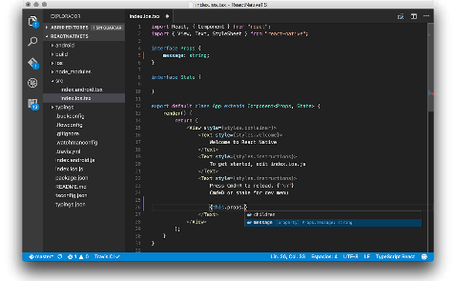
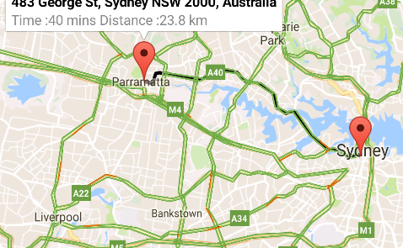
MOBILE APP DEVELOPMENT
REACT NATIVE
MAPPING AND GEOLOCATION
Cross-platform development frameworks such as React Native or Flutter will be used to build the user interface for real-time information presentation
Mapping and geolocation APIs, such as the Google Maps API, will integrate with the app to allow users to find the nearest working fountains.

Slide 10


